Slide 1
Zombie Crush
presented By
Mashrur Rashik Roll: 29
Mahmuder Rahman roll: 89

Slide 2
What Is Zombie Crush?
Zombie Crush is a single player game, inspired by window’s game zombie smasher.
It written in sfml, or most commonly known as simple fast multimedia library.
It has been written in C++ programming language.
Compiled using codeblocks IDE.

Slide 3
Objective of this Project
Basic use of a C++ graphics library.
Implementation of modular algorithm.
Learning basic functions of sfml library.
Learning uses of sprite in graphics.

Slide 4
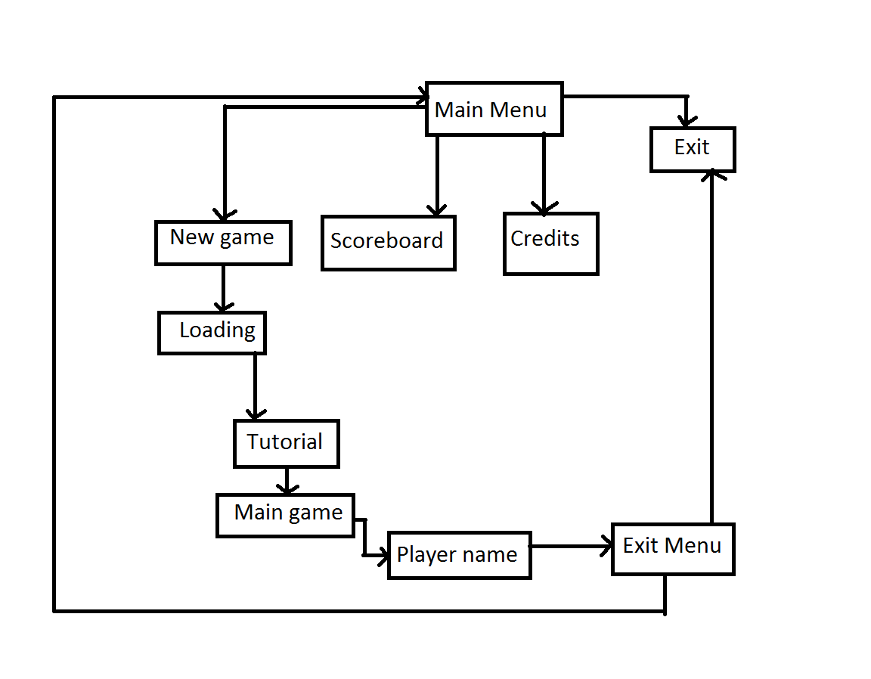
Structure of Game
Fig: Structure of game

Slide 5
Playing the Game

Slide 6
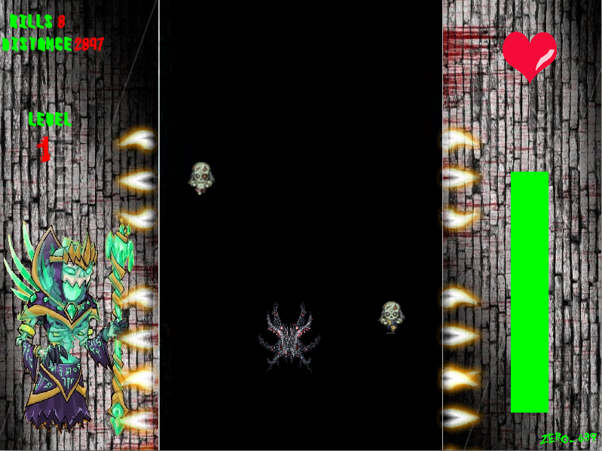
Level 1
Here Two zombies will appear.
The speed of the car will be slow.
Missing five zombies will result in game over.
Crossing 10000 km will result in increase in life.

Slide 7
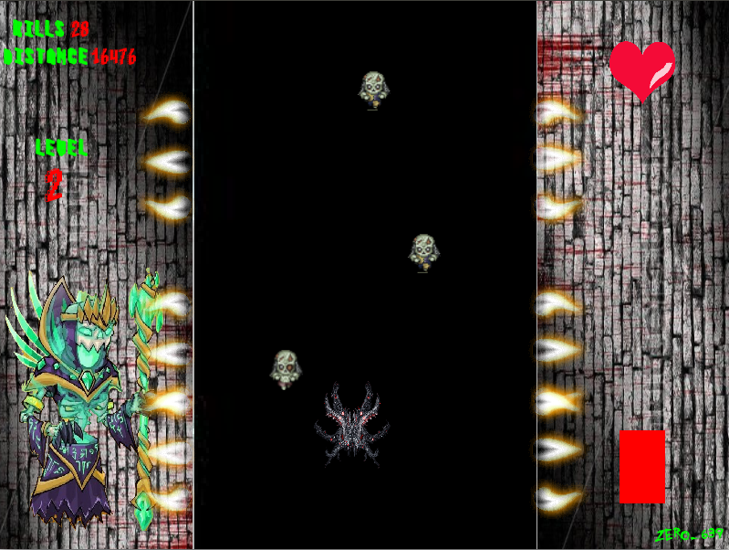
Level 2
Here three to four zombies will appear.
Like level 1, missing five zombies will result in game over.
Here the speed of the car is moderate and the difficulty level will be harder.

Slide 8
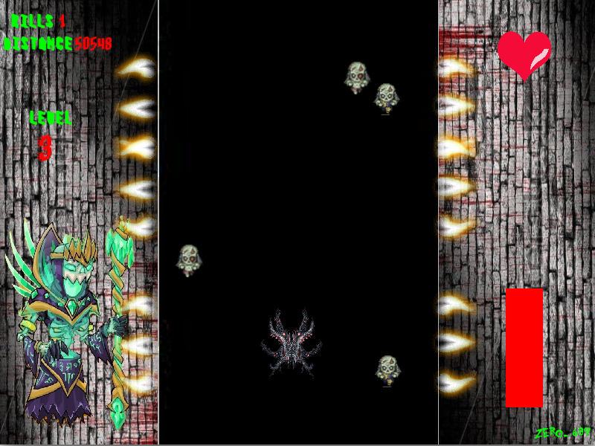
Level 3
Here a number of zombies will appear.
The accuracy level of the player will be tested as the speed of the car will be quite fast.
Like all other level, missing five zombies will result in game over, but here the misses of level 2 will be counted.

Slide 9
Working procedure of the game

Slide 10
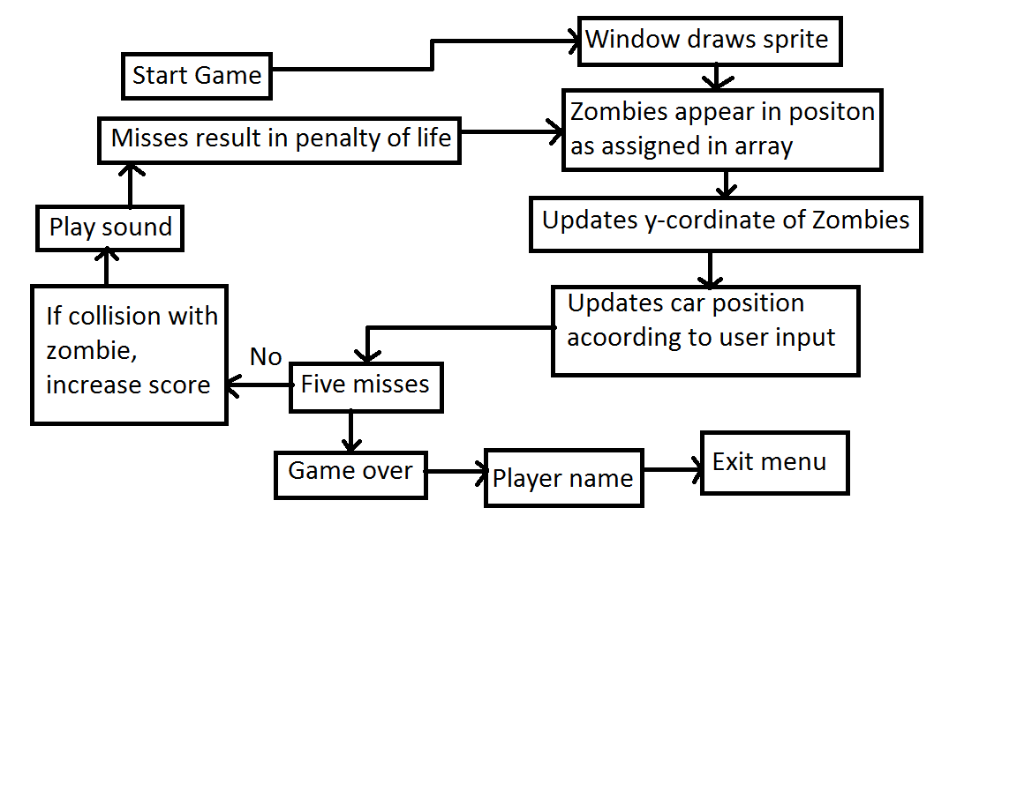
Basic logic of the game
Fig: Logic flow of the game

Slide 11
Chief attraction of the game

Slide 12
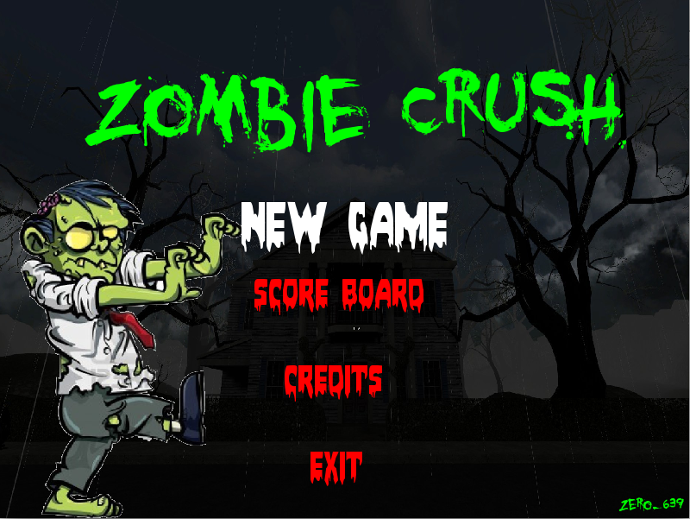
High execution speed
Here due to use of sfml the speed of execution of the program is quite fast.
Due to this the user can experience fast game play.
Due to use of sfml, and high execution, high graphics could be added.

Slide 13
Flicker free game
Here the window hasn’t been cleared with each stage of game, and due to this there is absolutely no flickering in the game.
This absolutely a flicker free game.

Slide 14
Sound effects
Here sound files has been added in the form of wav file.
Sound files are played in each window and also during game play.
Added to the beauty of the game.

Slide 15
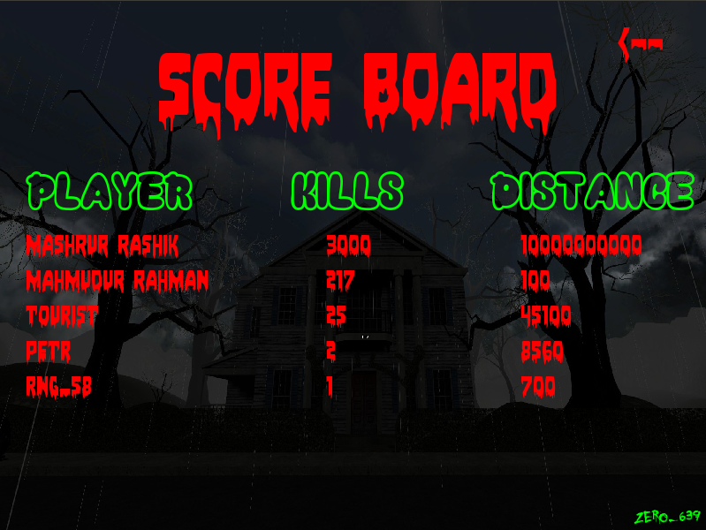
Addictive!!

Slide 16
Major Drawbacks

Slide 17
Till now no major bugs have been found expect for the high time consumption.

Slide 18
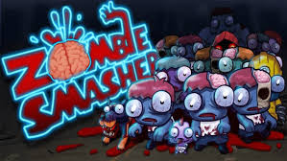
Inspired by
Inspired by the windows game “Zombie smasher”.

Slide 19
Summary
Great project to learn the use of C++ graphics library.
A great way to learn team work in graphics work.
Inspirational for future game development.

Slide 20
Special thanks
Md. Shiplu Hawlader, Lecturer, Department of CSE, DU.
Hasnain Heickal, Lecturer, Department of CSE, DU.
Mahmood Jasim, Lecturer, Department of CSE, DU.
Iffat Anjum, Lecturer, Department of CSE, DU.
Asma Enayet, Lecturer, Department of CSE, DU.
Tamal Adhikary, Lecturer, Department of CSE, DU.

Slide 21
Any Questions?

Slide 22
Thank you

